Slide 1
Engaging young minds in CS through game dev
Giuseppe Maggiore Università Ca’ Foscari di Venezia NHTV University of Breda

Slide 2
Agenda
The problem with young students and CS
3rd year university students
1st year university students
High school students

Slide 3

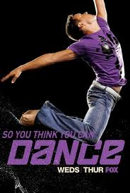
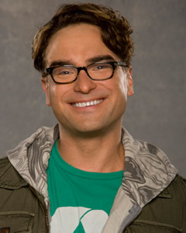

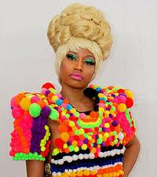


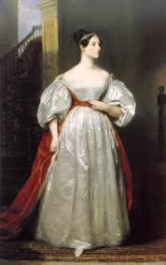


Problem statement
Not so many role models
vs

Slide 4
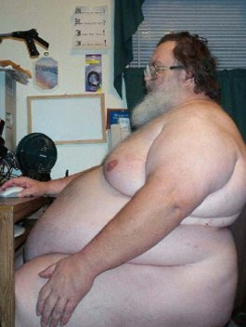
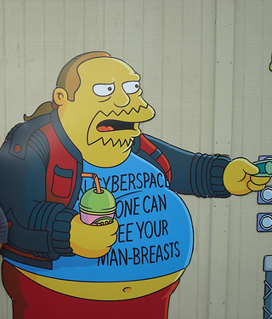
Problem statement
Even worse real-life examples

Slide 5
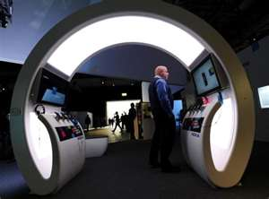



Problem statement
Rather high expectations

Slide 6
How do we cope?

Slide 7
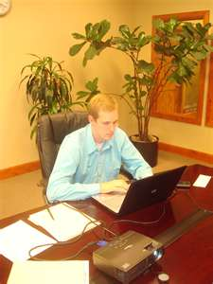

3rd year university students
Easier to work with
More knowledge
Less preconceptions
Can work with modern libraries and tools
Can work in teams
Significant investment in CS

Slide 8
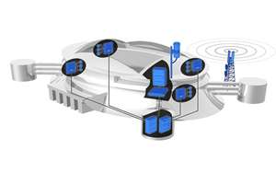
Objectives
Teach large scale software development
Usability
Concurrency
Performance
Integration with existing software
…

Slide 9
Course structure
Create a game
Around an existing logical library
AI, moves, etc.
Keep the program responsive
Library is rather slow
Concurrency

Slide 10
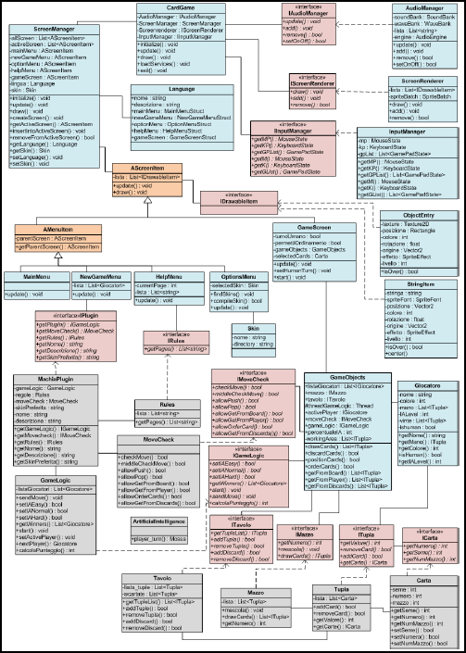
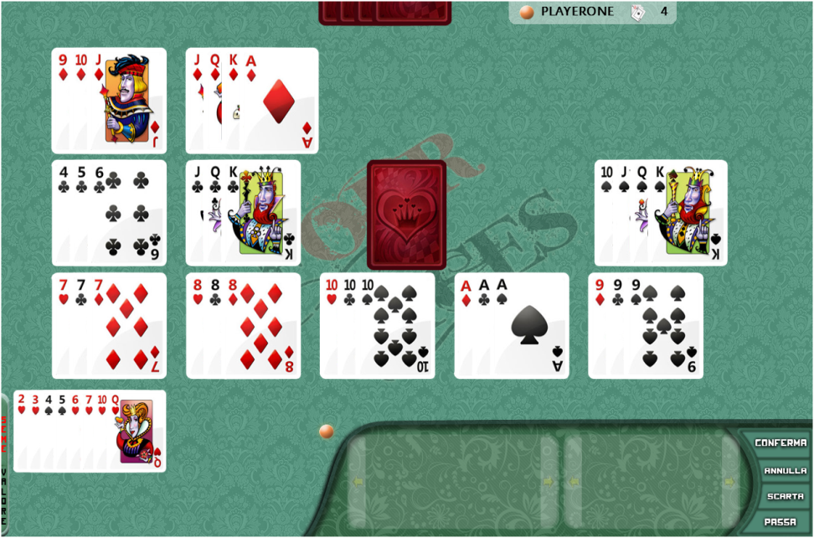
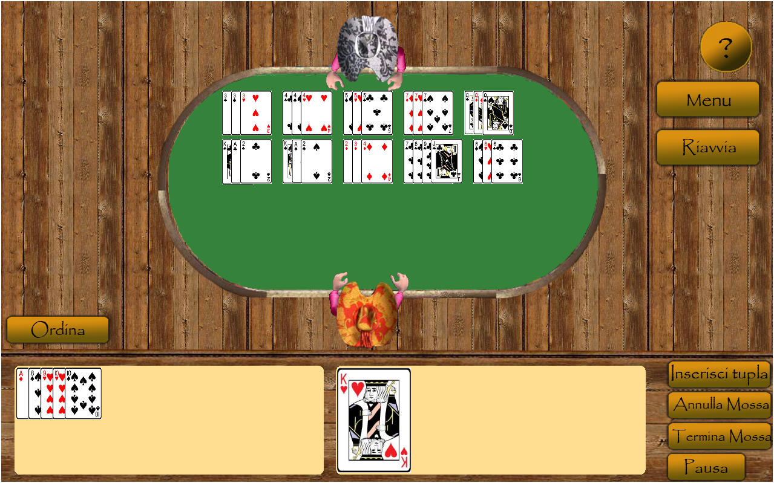
Results
Some works beyond expectations
Beautiful, usable applications
Huge, complex architectures
Happier students

Slide 11
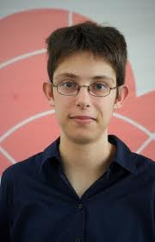

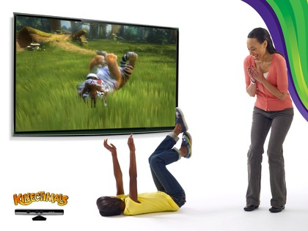
1st year university students
Harder task
Less knowledge
Bad study habits (no teams)
More expectations

Slide 12
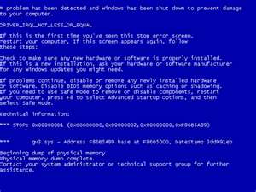
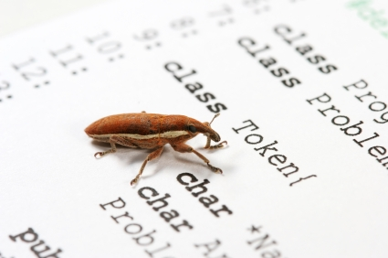
Objectives
Basic programming
Reasoning about programs
May not even start
May run and crash
May run, not crash, and still not work

Slide 13
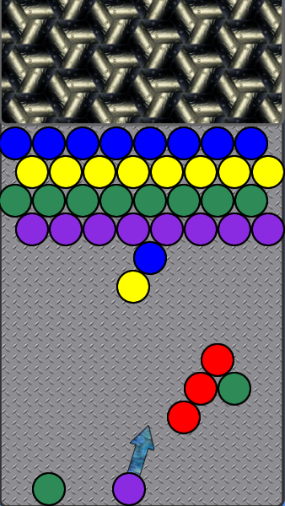
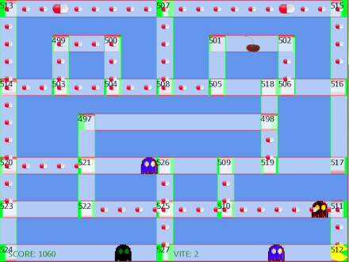
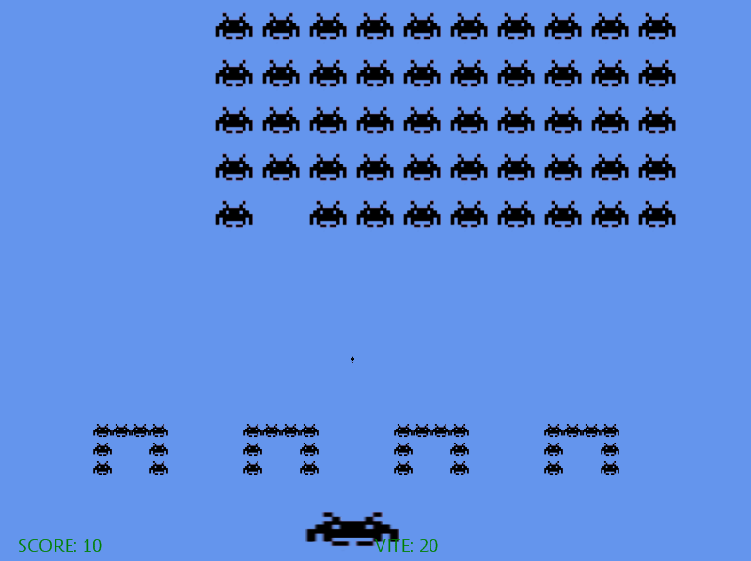
Course Structure
Ready-made games
They run
They don’t perform as expected
Run, test, fix, repeat

Slide 14
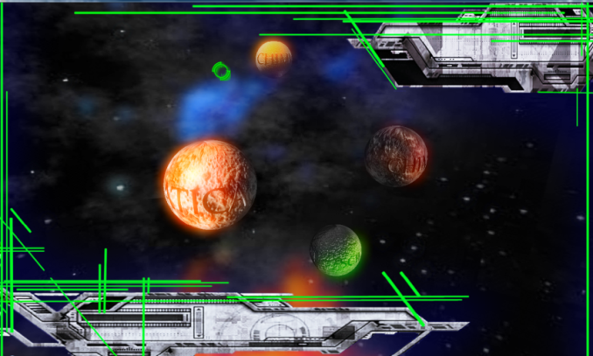
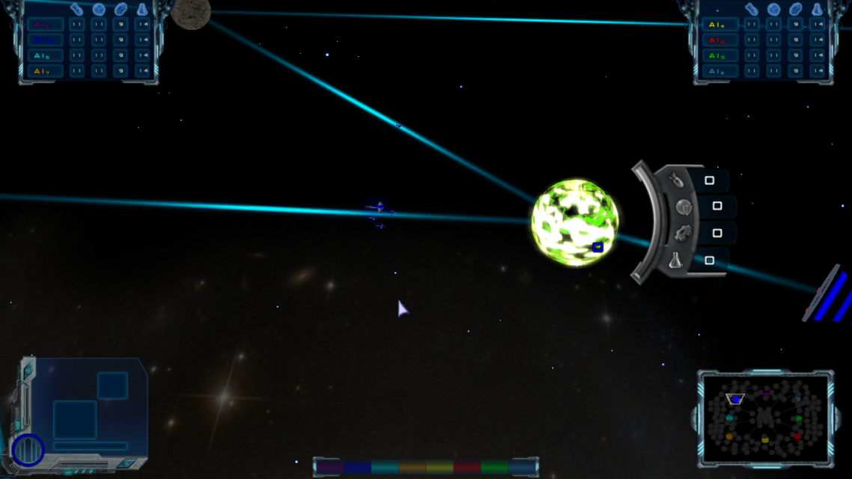
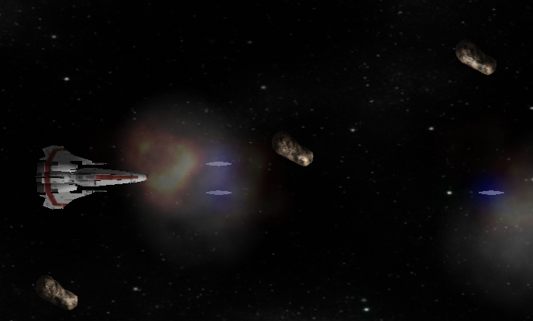
Results
High attendance
Some students were so engaged, they still work with us today!

Slide 15


High school students
Know nothing (about ICT ☺)
And what they may know is wrong
Very curious and open minded
Jump voraciously on any problem
Need to be kept interested
Digital natives

Slide 16
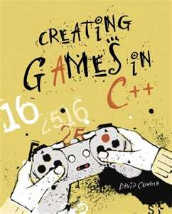
Objectives
“programming = logic + math + creativity”
Teach computational reasoning
Engage with fun, intuitive, visual experiences

Slide 17
Course(s) structure
Take a problem which can be visualized
Devise a series of mathematical/logical solutions of increasing quality
Provide a starting, almost broken sample
Let the students discover its flaws and apply the solutions in (2)

Slide 18
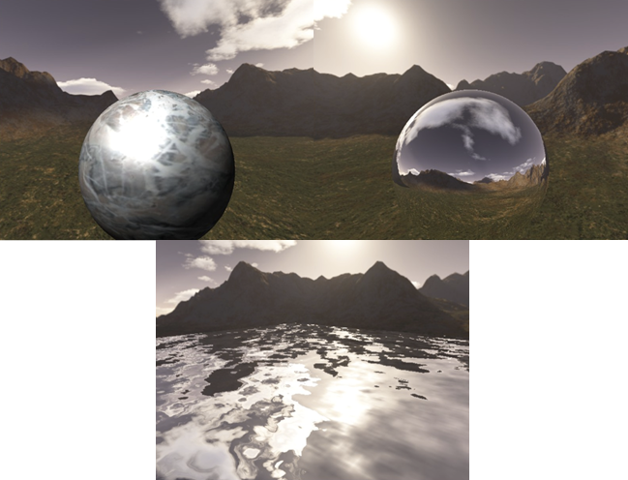
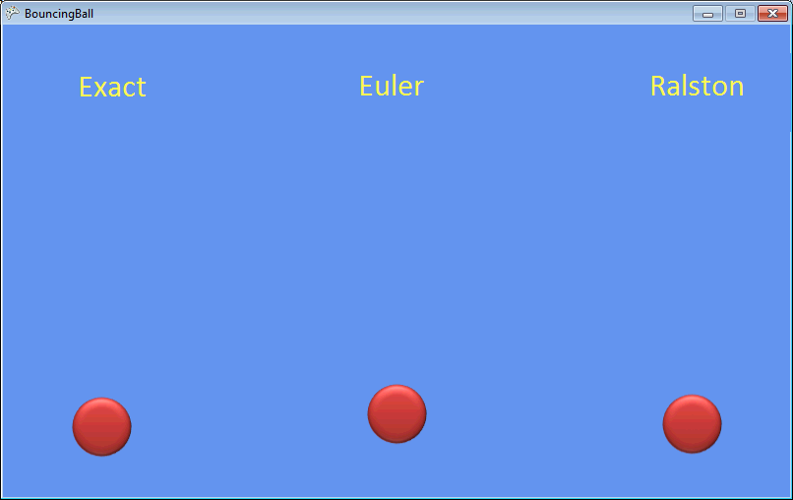
Some courses
Graphics simulations
Physics simulations
Computer vision

Slide 19

Results
Great students/teachers feedback
Increase in first year CS enrollment

Slide 20
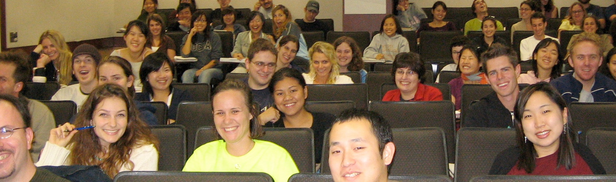
Conclusions
Role models
Out of our hands…
…but not completely; let’s create some!
Engaging students
Vibrant, real, fun, visual, interactive applications make for happy students

Slide 21
References
Friendly F# - Fun With Game Programming – Maggiore, Costantini
Game Programming as a non-threatening introduction to functional languages – Maggiore, Costantini, Cortesi
Learning by Fixing and Extending Games – Costantini, Maggiore, Cortesi
Engaging High School Students in Computer Science via
Challenging Applications – Maggiore, Torsello, Sartoretto, Cortesi

